Slide 1
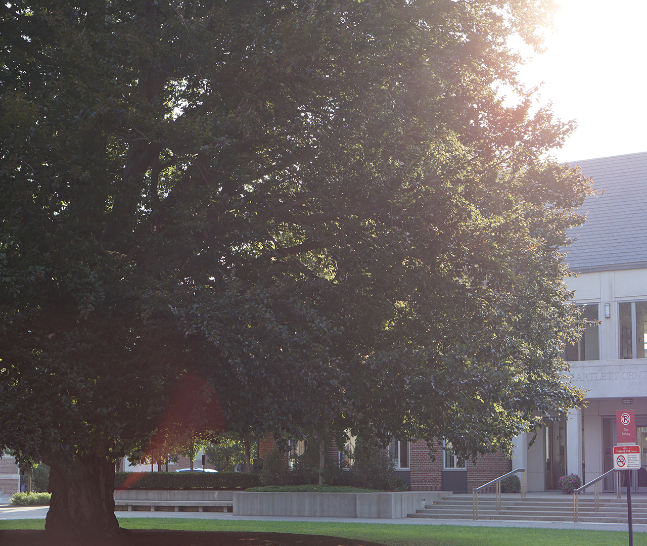
WPIn Love, Status Update Spell Shaded
Craig Bursey
Griffin Cecil
Jonella Esposito
Jimmy Tran

Slide 2
Group Roles
Jimmy Tran,
programmer
Griffin Cecil,
designer
Jonella Esposito,
artist
Craig Bursey,
secondary programmer/designer

Slide 3
Griffin Cecil, designer
Lead storyboard designer
Head writer
Testing and Debugging

Slide 4
Jimmy Tran, programmer
Wiring game together
Placeholders
Coding special effects/general aesthetics
Audio

Slide 5
Craig Bursey, secondary programmer/designer
Adding features
Coding and proofreading script
Testing/debugging
Managing presentations

Slide 6
Jonella Esposito, artist
Art assets
Character design
Logo design
Virtual art conversion

Slide 7
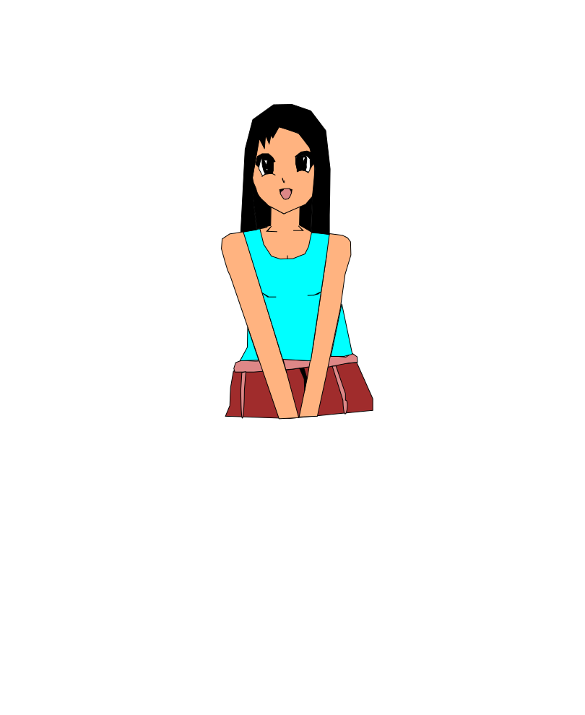
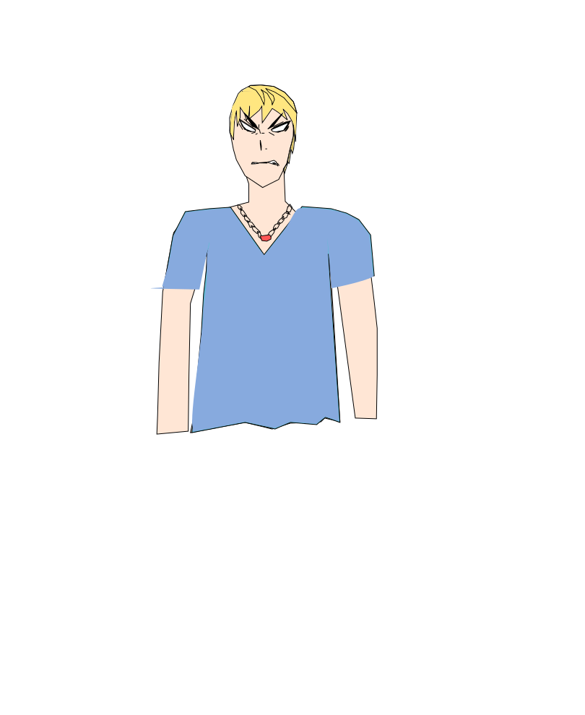
Art Samples

Slide 8
Title Screen; Scene 1
Game Samples!

Slide 9
What’s in Store for WPIn Love
Breaking from the default
Font
Music
Adding more special effects
Visual
Sound
Voice acting

Slide 10

What to cut?
The most dispensable aspects
of the game, in order:
Large chunks of dialogue (e.g. professor’s speech, dinner conversation, epilogue)
One emotion asset per character
Scene 3 in its entirety; scene 8 on male side

